Slide 1


110: Chess Checkmate
Kevin, Callum, Steven, Evan

Slide 2

Summary
This project aims to detect if our king is in checkmate. We are assuming that our king is our only friendly piece left, and if there are no safe squares for our king to move to then it is checkmate. For this project we will be ignoring pieces blocking each other’s path to achieve checkmate. Additionally, we ignore the possibility of the enemy king being in checkmate (we only look at our king). Our solution will take a given chess board configuration, and can place a limited number of additional pieces to achieve checkmate (e.g. it may be given 1 extra pawn to place on the board).
Note: If you are unfamiliar with chess, it is recommended that you read a brief overview here. Primarily, understanding the movement of pieces and the concept of checkmate is required to comprehend our solution.
8
7
6
5
4
3
2
1
1 2 3 4 5 6 7 8

Slide 3
Summary (CONT.)
To implement this, we converted the information of piece placement on the grid into propositions. Also, the rules of chess (in piece movement) were translated into constraints to show whether the King given is in checkmate. If all spaces surrounding the King can be moved to be enemy pieces, then the King is in checkmate.
When exploring the problem, we tried a number of checkmate solutions (and near checkmate solutions) to test the validity of our solution. In near checkmate solutions, given the solution one or more additional pieces to place proved that it can produce checkmate based on the constraints given.
8
7
6
5
4
3
2
1
1 2 3 4 5 6 7 8

Slide 4
Propositions
S_{ij} - is considered true if the enemy can move into the space - i.e. the space is "not safe" (i, j)
K_{ij} - is considered true if the friendly King is in that space
The logic for the friendly King applies for all enemies, for example:
b_{ij} is considered true if an enemy bishop occupies that square
This applies to enemy pawns (p), enemy queens (q), enemy kings (k), enemy knights (n), and enemy rooks (r)

Slide 5
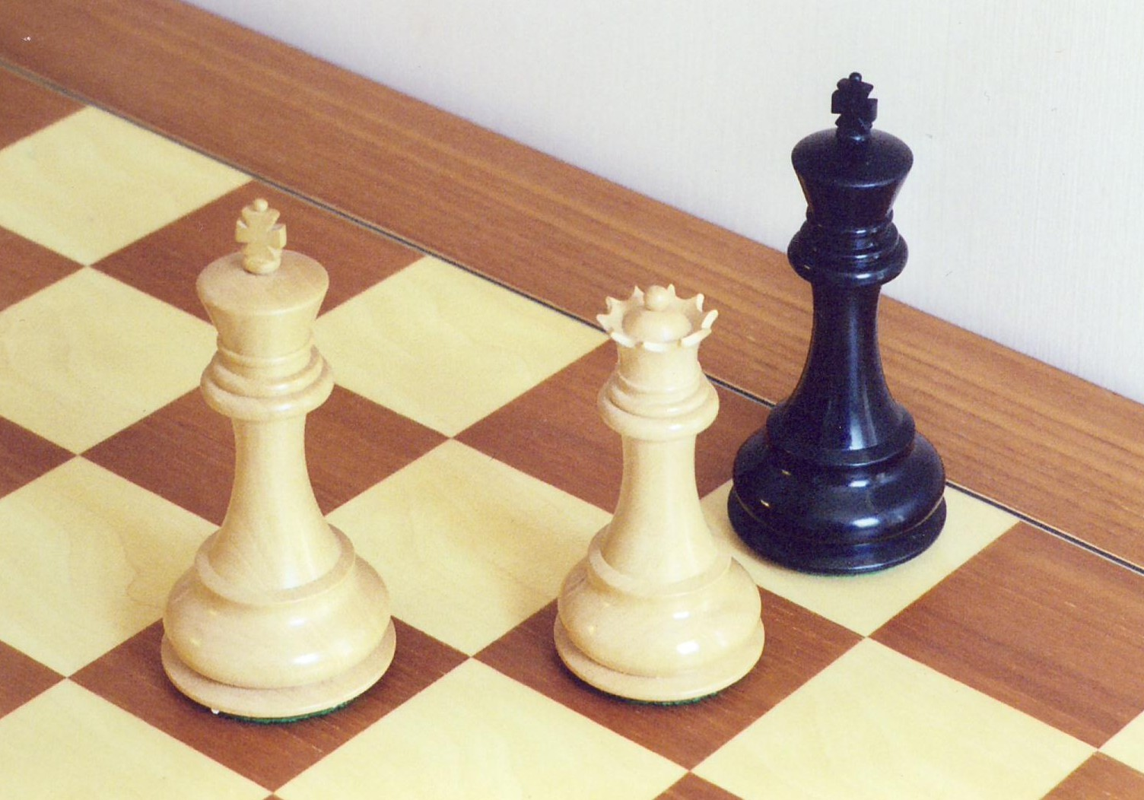
Constraints (CHECKMATE)
i and j must be within 1 and n inclusive, where n is the grid size (which would be 8, for a standard chess board)
The Friendly King does not have a safe space to move to (checkmate): K_{i,j} →(S_{i+1,j-1} ∧ S_{i+1,j} ∧ S_{i+1,j+1} ∧ S_{i,j+1} ∧ S_{i,j-1} ∧ S_{i-1,j-1} ∧ S_{i-1,j} ∧ S_{i-1,j+1})
Pawn covers diagonals in front of them: p_{i,j} → (S_{i+1,j-1} ∧ S_{i+1,j+1})
Rook covers up, down, left, right: r_{i,j} → (S_{i-1,j} ∧…∧S_{i-7,j} )∧(S_{i+1,j} ∧…∧S_{i+7,j} )∧(S_{i,j-1} ∧…∧S_{i,j-7})∧(S_{i,j+1} ∧…. ∧S_{i,j+7})
Bishop covers diagonals : b_{i,j} → (S_{i+1,j+1} ∧…∧S_{i+7,j+7}) ∧ (S_{i-1,j-1} ∧…∧S_{i-7,j-7}) ∧ (S_{i+1,j-1} ∧…∧S_{i+7,j-7}) ∧ (S_{i-1,+-1} ∧…∧S_{i-7,j+7})
Queen: q_{i,j} → combines the constraints of rook and bishop
King covers the spaces around them: k_{i,j} → (S_{i+1,j-1} ∧ S_{i+1,j} ∧ S_{i+1,j+1} ∧ S_{i,j+1} ∧ S_{i,j-1} ∧ S_{i-1,j-1} ∧ S_{i-1,j} ∧ S_{i-1,j+1})
Knight covers the other end of the L: n_{i,j} → (S_{i+1,j-2} ∧S_{i+2,j-1} ∧S_{i+2,j+1} ∧S_{i+1,j+2} ∧S_{i-1,j+2} ∧S_{i-2,j+1} ∧S_{i-2,j-1} ∧S_{i-11,j-2} )

Slide 6
Constraints (CHECKMATE)
A space is safe (not "not safe") if and only if no enemy pieces can move into it: ¬S_{i,j} ⇔ (p_{i-1,j-1}∧ p_{i-1,j+1})∧(r_{i-1,j}∧…∧r_{i-7,j}) ∧
(r_{i+1,j}∧…∧r_{i+7,j}) ∧ (r_{i,j-1}∧…∧r_{i,j-7}) ∧ (r_{i,j+1}∧…. ∧r_{i,j+7}) ∧ (b_{i+1,j+1}∧…∧b_{i+7,j+7}) ∧ (b_{i-1,j-1}∧…∧b_{i-7,j-7}) ∧
(b_{i+1,j-1}∧…∧b_{i+7,j-7}) ∧ (b_{i-1,+-1}∧…∧b_{i-7,j+7})…...
Multiple pieces cannot occupy the same space:
q_{i,j} → ¬r_{i,j} ∧ ¬b_{i,j} ∧ ¬n_{i,j} ∧ ¬k_{i,j} ∧ ¬p_{i,j} ∧ ¬K_{i,j}
r_{i,j} → ¬q_{i,j} ∧ ¬b_{i,j} ∧ ¬n_{i,j} ∧ ¬k_{i,j} ∧ ¬p_{i,j} ∧ ¬K_{i,j}
… And so on for every enemy piece
We start with an initial configuration for all pieces, for example:
q_{7,5} ∧ k_{6,4} ∧ K_{8,5}

Slide 7
Constraints (CHECKMATE)
Pieces can be placed in any combination of locations (limited by the number of pieces given) on the board. This will imply that these pieces cannot be in any other location on the board. For example, if 3 queens are given to be placed on a 3x3 grid:
q_{1,3} ∧ q_{2,2} ∧ q_{3,2} → ¬q_{1,1} ∧ ¬q_{1,2} ∧ ¬q_{2,1} ∧ ¬q_{2,3} ∧ ¬q_{3,1} ∧ ¬q_{3,3} would be one of the constraints
There would be a constraint (like the one above) for every possible combination of three positions (that also implies the queens are not in any of the other positions). This will force the algorithm to choose a set of positions for the pieces to be placed, or to not place the pieces at all.
In the future, constraints for fewer than the given number of pieces could be implemented (e.g. having constraints for 1, 2, and 3 queens being placed if 3 queens are given).

Slide 8
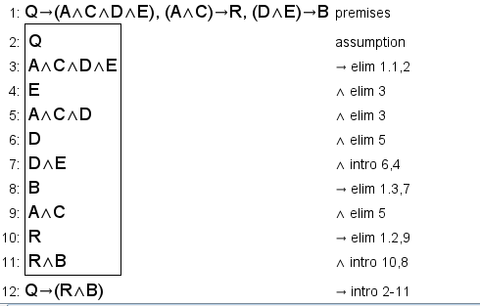
Jape Proof 1
*Important: There are extra proofs in the jape file, but the 3 we are intending to submit are saved in a way such that when you open the file, the 3 newest proofs will be opened (they are also displayed on this and the following 2 slides for clarification).
Given a queen's, rook's and bishop's movement abilities, we can conclude that a queen's moves is the combination of a rook and bishop
R is rook
A is up/down
C is left/right
B is bishop
D is diagonal right
E is diagonal left
Q is queen

Slide 9
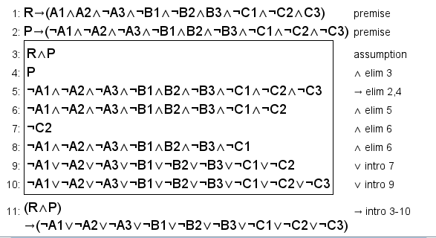
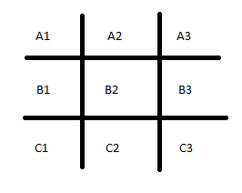
Jape Proof 2
Given the 3x3 grid in the bottom right, if there is a rook on A3 and a pawn on C1, we can deduce that the is a possibility the king will survive the round.
R is rook
P is pawn
A1 is true when it is not safe
A1is not true when it is safe
Above two squares apply to all grid squares
Must be at least one safe square in the combination of the rook and pawn square for there to be a possible not check mate if the king was in said safe square or moved to said safe square

Slide 10
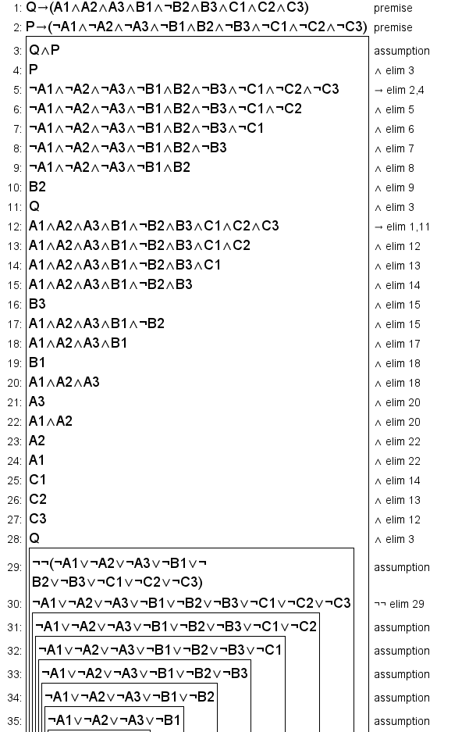
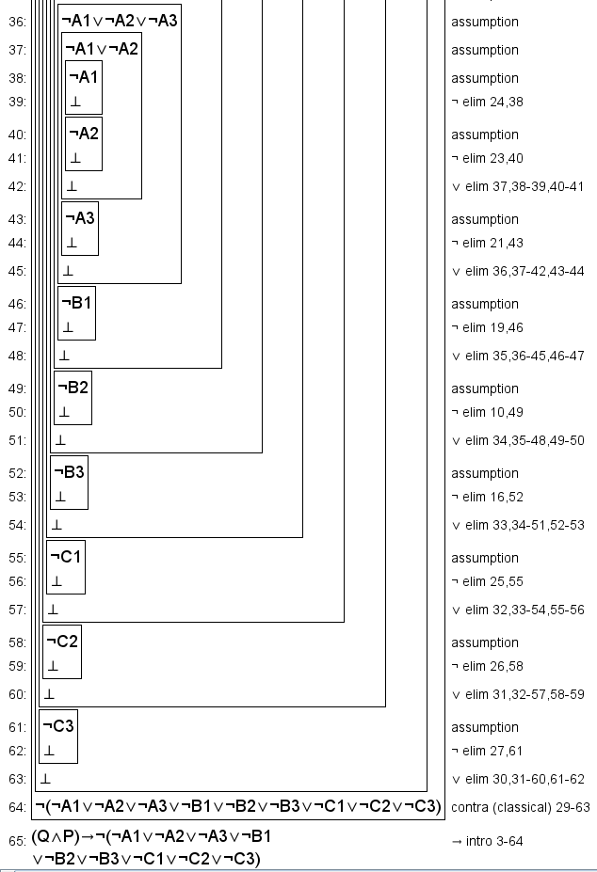
Jape Proof 3
Given the 3x3 grid below, if there is a queen on B2 and a pawn on C3, we can deduce that there is not safe space for a king to survive the round.
Q is queen
P is pawn
A1 is true when it is not safe
A1 is not true when it is safe
Above two rules apply to all grid squares
Must be no safe squares in the combination of the queen and pawn squares for the entire grid to be not safe, then the regardless of the king's position, it cannot survive the round if it is the opponent's move

Slide 11
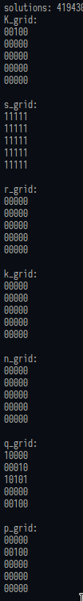
Model Exploration
We have explored our model by experimenting with different grid sizes from 3x3 to 6x6 and verified that the given s grids are correct. By this, we mean that the solution we created can interpret different starting grids, and will correctly identify where pieces can move to (and thus, where a King cannot move to). By testing a variety of different piece starting positions, and confirming the correct grid outputs, we have determined that our solution is valid.
We found out that using a 3x3 to 6x6 grid can make our model more clear and easier to understand (the larger the grid, the longer it'll take to solve – so we did not use 8x8 when running the project). Specifically, some complex 5x5 grids will cause the recursion limit to be reached (although this appears to vary depending on the machine the code is running on). As such, the complexity of the models tested were limited in scope (with most of the more complicated models being tested on smaller grid sizes).
In the python project we determined that a square is safe if and only if there are no pieces that can move into that square (and if the model is satisfiable, then there is a checkmate). For example, one of the tests we did for the 5x5 grid is shown on the right.

Slide 12
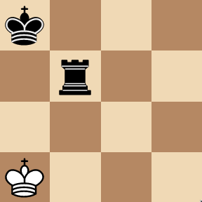
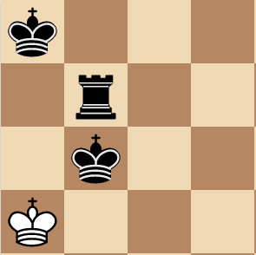
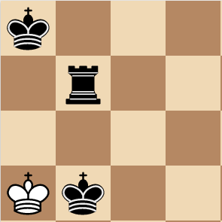
Model Exploration (CONT.)
Model Exploration Example 1:
Initial board configuration given on the right (a 4x4 grid)
Given 1 enemy king to place
Results:
2 solutions found
Enemy king can be placed in one of the two squares directly below the rook (such that the king blocks the enemy king from moving, and the rook protects the added king)
Shows how having one piece beside the white King, while protected by another is a good technique for checkmate (the piece beside the white king can be anything, however the king and queen are ideal due to the variety of movements they can perform)
Starting grid:
Solutions:

Slide 13
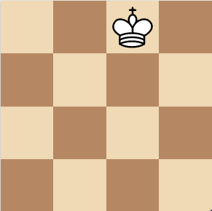
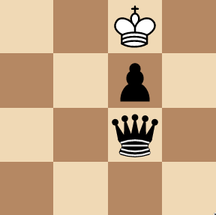
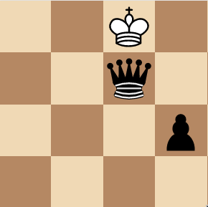
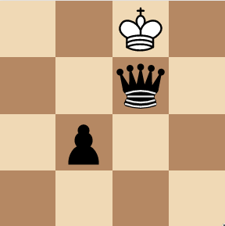
Model Exploration (CONT.)
Model Exploration Example 2:
Initial board configuration given on the right (a 4x4 grid)
Given 1 queen and 1 pawn to place
Results:
3 solutions found below
All use a queen defending the pawn, or vice versa to achieve checkmate (showing that these are common or more ideal techniques for achieving checkmate with only a few pieces)
Starting grid:
Solutions:

Slide 14
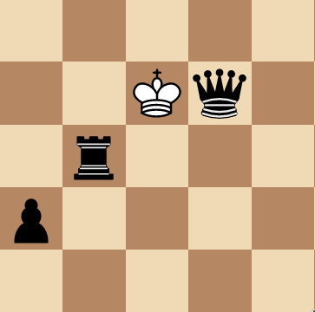
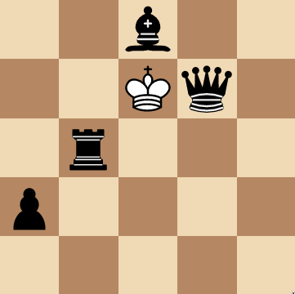
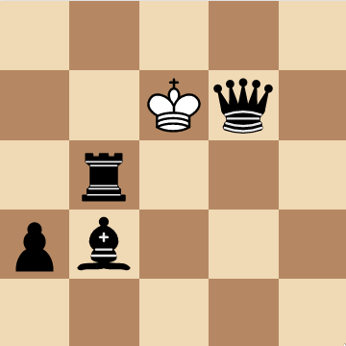
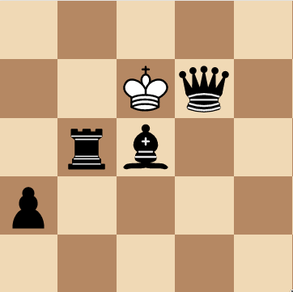
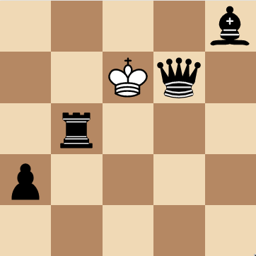
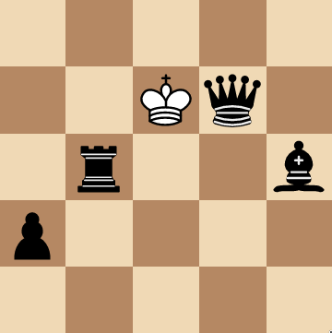
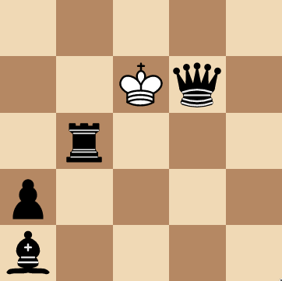
Model Exploration (CONT.)
Model Exploration Example 3:
Initial board configuration given on the right (a 5x5 grid)
Given 1 bishop to place
Results:
6 solutions found below
Here, we can see that a queen is incredibly useful in making checkmate (as long as a queen is beside the white King and is protected, checkmate is achieved)
Starting grid:
Solutions:

Slide 15
First-order extension
We can add quantifiers for rows and columns for each (relevant) piece. For example, a rook "not safe" grid would be "for all spaces in this row and for all spaces in this column", the rook will make the entire row and column "not safe".
∀x_{i,j}(R(x_{i,j})→(¬r(i) ∧ ¬C(j))), here the predicate r(i) is true if the row given is all safe, and C(j) is true if the column given is all safe.
Predicates would represent whether a given square has a piece. For example, P(x) would be true if the given square x_{i,j} has a pawn. Additionally, predicates could be made for whether certain squares, rows, and columns are safe.
∀x_{i,j}(P(x_{i,j})→(¬S(x_{i+1,j+1}) ∧ ¬S(x_{i+1,j-1}))) is an example constraint that states all pawns imply that the two squares in front of it on diagonals are not safe.
We can add similar quantifiers using this principal for the queen and bishop (with diagonals included, although this may be more difficult to express in propositional logic).
We hope in this project the algorithm checkmate situation could be use in solve some real-life problems. For example, if the algorithm is improved in its efficiency, then it could be used in the creation of a chess AI (one that could move pieces to achieve checkmate in a future board arrangement). Additionally, a modified algorithm could be used to solve forms of puzzles and other problems, such as the n-queens problem.

Slide 16
End

